Slide 1
GENERATIVE AI MODEL FROM SCRATCH
TEAM MEMBERS:
VENKATA SAI KUMAR(1SI22AD054)
RUSHIKESH(1SI22AD045)
NASIR HUSEN(1SI23AD407)
UNDER THE GUIDANCE OF:
DR.R M SAVITHRSMMA

Slide 2
Introduction: Generative AI Model for Text Generation
This mini project focuses on developing a generative AI model capable of producing human-like text. We will leverage the power of Recurrent Neural Networks (RNNs), specifically [Mention the type of RNN you are using, e.g., LSTM or GRU], to build a model that can learn patterns and relationships within text data.
By training the RNN model on a large dataset of text, it will learn to predict the next word or character in a sequence, allowing it to generate novel and creative text. Our goal is to create a model that can generate coherent and engaging text that is relevant to the given prompt, adapting to different styles, tones, and domains.
This project will involve data collection, preprocessing, model training and evaluation, and ultimately, demonstrating the capabilities of our generative AI model.

Slide 3
AIM AND OBJECTIVE
AIM :Generative AI Model for Text Generation
Objective:
This project aims to build a generative AI model that can create high-quality text. The model should be able to:
Generate coherent and relevant text: The output should make sense and stay on topic, with a clear and consistent flow from beginning to end.
Adapt to different styles and tones: The model should be able to produce text that matches the desired style, tone, and subject matter, whether it's formal or informal, creative or technical.
Produce original and diverse content: The model should avoid repetition and generate unique and interesting text each time.

Slide 4
Literature Survey
TITLE | YEAR | OBJECTIVE | BENEFITS | LIMITATIONS | FUTURE WORK
A Survey on Text Generation Using Generative Adversarial Networks | 2021 | To provide a comprehensive overview of text generation techniques using GANs. | High-quality text generation, improved diversity, and controllability. | Limited control over generated text, potential instability during training. | Explore new GAN architectures, improve training stability, and enhance control over generated text characteristics.
A Systematic Literature Review on Text Generation Using Deep Neural Network Models | 2022 | To review and analyze recent advancements in text generation using deep learning models, focusing on RNNs, LSTMs, and Transformers. | High-quality text generation, improved fluency, and better control over generated text. | Computational cost, potential for generating biased or repetitive text. | Explore more efficient architectures, develop methods for mitigating bias, and improve the diversity of generated text.
Recent Advances in Generative AI and Large Language Models: Current Status, Challenges, and Perspectives | 2024 | To provide an overview of the current state of generative AI, focusing on large language models, and discuss the challenges and future directions. | High-quality text generation, improved understanding of language, and potential for a wide range of applications. | Computational cost, potential for bias and misinformation, and ethical concerns. | Develop more efficient and ethical models, improve controllability, and explore new applications in various domains.

Slide 5
TITLE | YEAR | OBJECTIVE | BENEFITS | LIMITATIONS | FUTURE WORK
Advanced Generative AI Methods for Academic Text Summarization | 2024 | To explore the application of advanced generative AI techniques for summarizing academic text. | Improved accuracy and conciseness of summaries, improved readability, and potential for personalized summaries. | Challenges in handling complex sentence structures and maintaining the original meaning of the text. | Develop more robust models that can handle complex language and improve the ability to generate summaries that are both accurate and informative.
Adversarial Machine Learning in Text Processing: A Literature Survey | 2022 | To review and analyze adversarial machine learning techniques applied to text processing tasks, including text generation. | Improved robustness and security of text generation models, better understanding of vulnerabilities, and potential for developing more resilient systems. | Limited research on specific text generation tasks, and potential for adversarial attacks to be used maliciously. | Explore new defense mechanisms, develop more robust and secure text generation models, and investigate the ethical implications of adversarial attacks.

Slide 6
State diagram

Slide 7
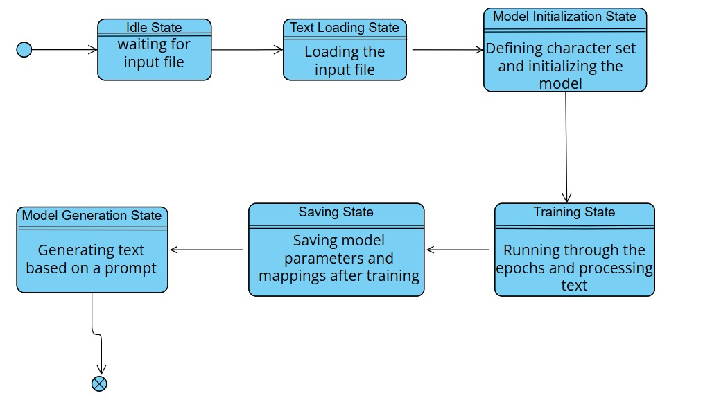

Slide 8
Operational flow chart

Slide 9
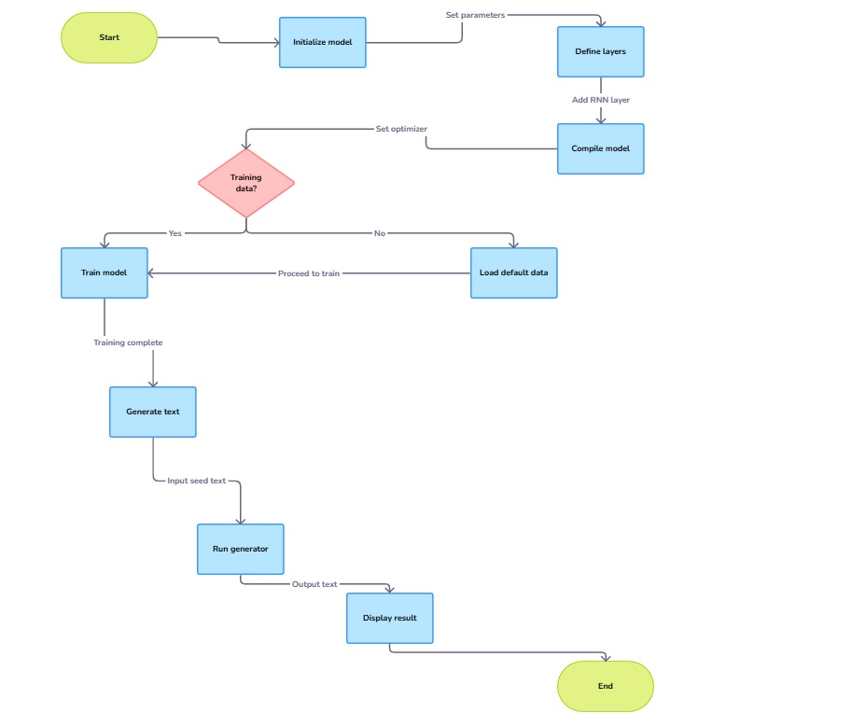

Slide 10
Requirements
Hardware Requirements
GPU: A dedicated GPU (e.g., NVIDIA RTX or Tesla) is highly recommended for accelerating the training
process of deep learning models, especially RNNs.
Storage: Sufficient SSD storage (at least 256 GB) is necessary to accommodate the training dataset,
model checkpoints, and intermediate files.
Software Requirements
Operating System:
Linux (Ubuntu recommended) is generally preferred for deep learning due to its compatibility and
performance.
Windows and macOS can also be used, but may require additional setup and configuration.
Deep Learning Framework:
TensorFlow or PyTorch: These are the most popular and widely used frameworks for building and
training neural networks. Choose one based on your preference and the specific needs of your project.
Development Environment:
Python: The primary programming language for AI development.
Jupyter Notebook: An excellent tool for interactive coding, data exploration, and visualization

Slide 11
Libraries
NumPy: Fundamental package for numerical computing in Python.
Pandas: Powerful library for data manipulation and analysis.
Keras: (if using TensorFlow) High-level API that simplifies the process of building and training neural networks.
Dataset Requirements
Text Corpus: A large and diverse text corpus is essential for training a robust text generation model. The dataset should be relevant to the specific tasks and domains you intend to target. Examples include:
Books, articles, and news articles
Dialogues and conversations
Codebases
Data Preprocessing:
Tokenization: Breaking down the text into individual words or sub-words.
Normalization: Handling inconsistencies like capitalization, punctuation, and special characters.
Cleaning: Removing noise and irrelevant data.
Data Augmentation: (Optional) Techniques like:
Back-translation: Translating the text to another language and then back to the original.
Text perturbation: Introducing slight variations to the text (e.g., synonyms, paraphrasing).

Slide 12
References
de Rosa, G. H., & Papa, J. P. (2021). A survey on text generation using generative adversarial networks. Pattern Recognition, 119, 108098. https://doi.org/10.1016/j.patcog.2021.108098
Fatima, N., Imran, A. S., Kastrati, Z., Daudpota, S. M., & Soomro, A. (2022). A systematic literature review on text generation using deep neural network models. IEEE Access, 10, 53490-53503. https://doi.org/10.1109/ACCESS.2022.3174108
Hagos, D. H., Battle, R., & Rawat, D. B. (2024). Recent advances in generative AI and large language models: Current status, challenges, and perspectives. IEEE Transactions on Artificial Intelligence. https://doi.org/10.1109/TAI.2024.3444742
Dar, Z., Raheel, M., Bokhari, U., Jamil, A., Alazzawi, E. M., & Hameed, A. A. (2024). Advanced generative AI methods for academic text summarization. In 2024 IEEE 3rd International Conference on Computing and Machine Intelligence (ICMI) (pp. 1-7). https://doi.org/10.1109/ICMI60790.2024.10585622

Slide 13
List and describe the application
1. Creative Writing Assistance:
Storytelling: Generate creative stories, poems, or scripts based on user-provided prompts, character descriptions, or plot outlines.
2. Content Creation:
Article Generation: Produce news summaries, product descriptions, or marketing copy based on input data.
3. Educational Tools:
Language Learning: reading materials for language learners.
4. Research and Development:
Natural Language Processing (NLP) research: Explore and advance the field of NLP by developing and improving text generation models.

Slide 14
Conclusion
This project aimed to build an AI model that can generate human-like text. We used an RNN to achieve this. Our model learned from a large dataset of text and can now generate text based on given prompts.
The model was able to generate short poems, simple stories.
While the model works well, we can still improve it by using better data, trying different model architectures, and making sure the generated text is fair and unbiased.
This project shows that AI can be used to create creative and useful text, and we believe that with further research, generative AI will have many exciting applications in the future.

